Slide 1
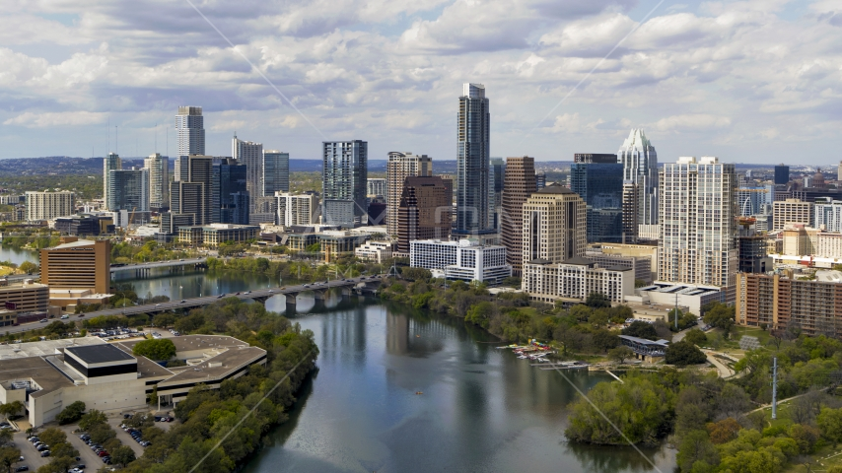
CRIME IN THE TIME OF COVID
AUSTIN TX

Slide 2
Agenda
Project Team Members
The Data & Timeline
Crime in Austin TX
February – July 2019 vs February – July 2020
Source API: https://data.austintexas.gov/
Questions
Analysis
Conclusions

Slide 3
Our Team
DAVID RICHTER Assistant Team Leader
RICK HAUGAN Project 1 Team Member
IBET HERNANDEZ Project 1 Team Member
VANESSA SIMPSON Project 1 Team Member
SHANNON VILLEMEZ Project 1 Team Member
OMAR ALI Team Leader

Slide 4

The Data
Source Domain: data.austintexas.gov
Crime Reports API Dataset Identifier: fdj4-gpfu
Total Rows: 2259648 Total Columns: 27 (2013 to date)
Category: Public Safety
Attribution: Austin Police Department
License: Public Domain
Incident Number
Highest Offense Description
Highest Offense Code
Family Violence (Y/N)
Occurred Date/Time
Reported Date/Time
Location Type
Address
Zip Code
X Coordinate
Y Coordinate
Latitude
Longitude

Slide 5
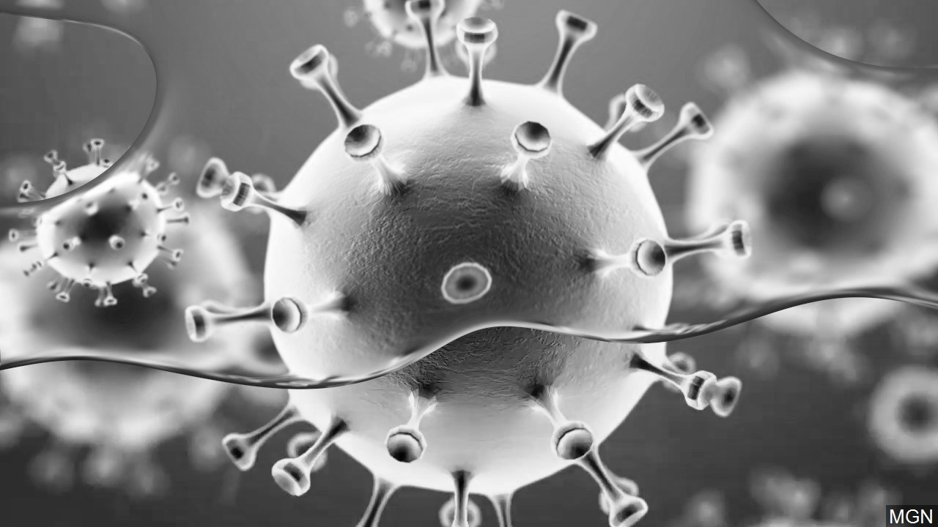
2020 covid timeline
February
January 31 –
U.S. bans travelers from China
March
March 17 – Gatherings limited to 10 people non-essential businesses and services shut down
April
April 24 –
Retail Businesses allowed to reopen
May
May 1 –
Restaurants are allowed to reopen
May 22 –
Bars are allowed to reopen
May 26 –
George Floyd Protests Begin
June
June 26 –
Bars are shut down again
July

Slide 6
QUESTIONS
Did overall crime increase or decrease?
Was there a change in crime by location? (Google Maps vs Plotly)
What crime categories went up?
What crime categories went down?
Were there unusual changes associated with the timeline of events?

Slide 7
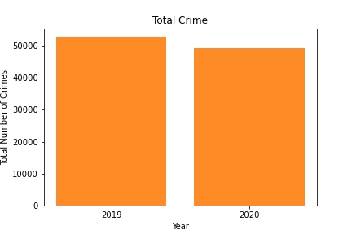
total crime

Slide 8
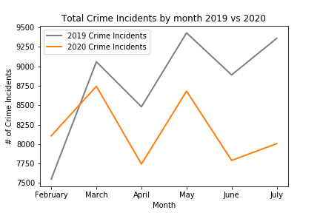
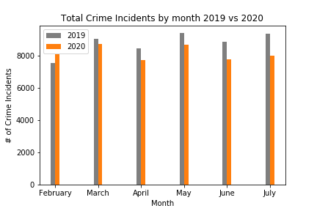
Total Crime
BY MONTH
TOTAL

Slide 9
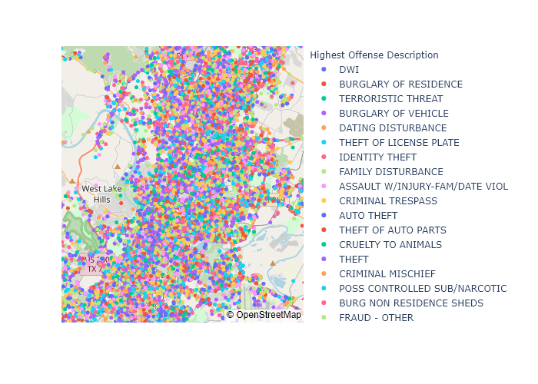
all crimes BY LOCATION
2019

Slide 10
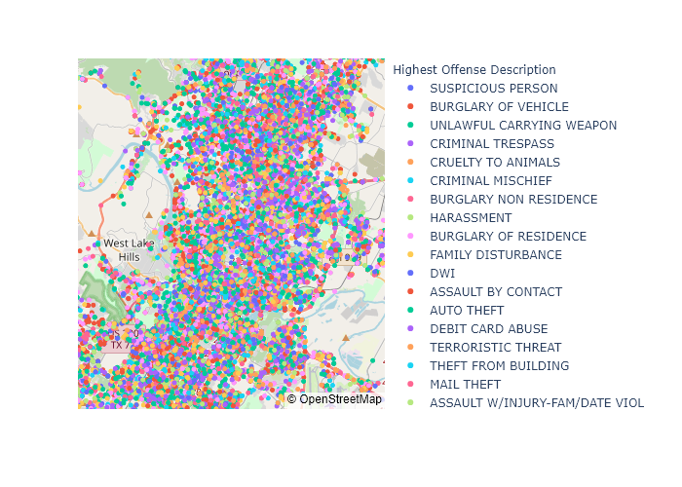
All crimes BY LOCATION
2020

Slide 11
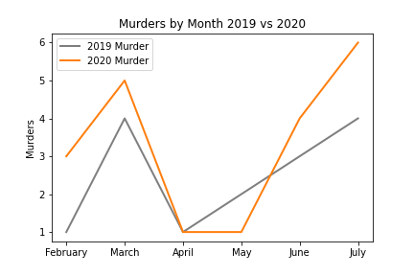
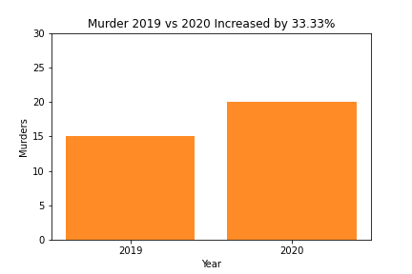
murder
BY MONTH
TOTAL

Slide 12
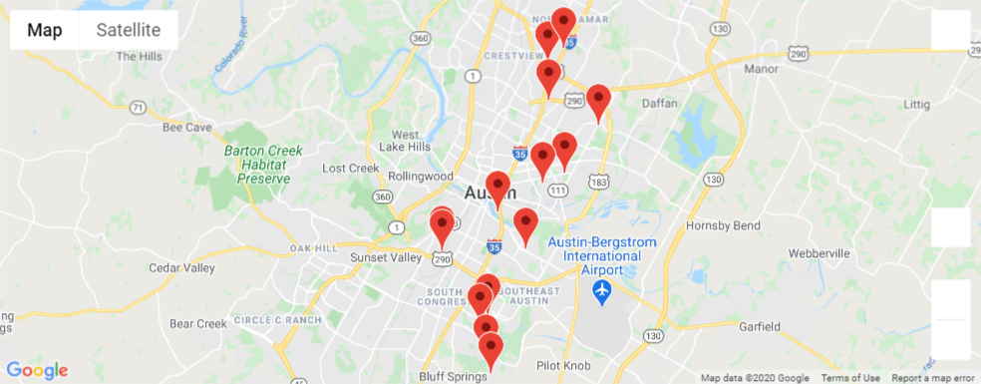
Murder 2019

Slide 13
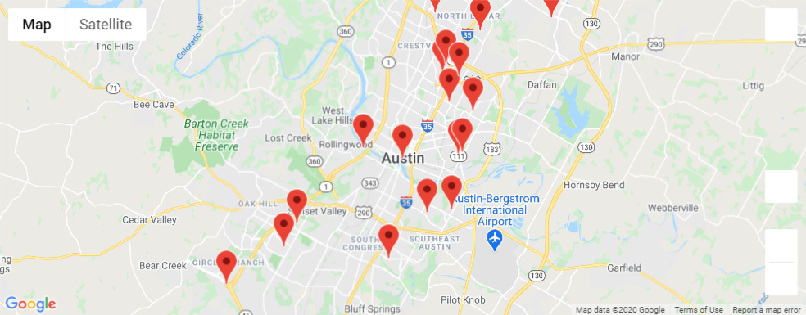
Murder 2020

Slide 14
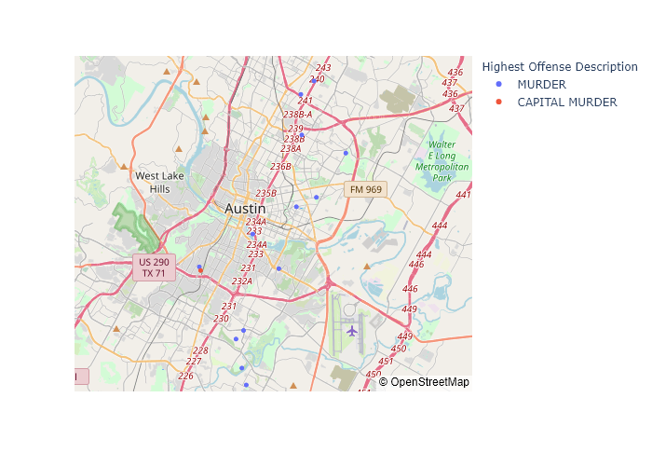
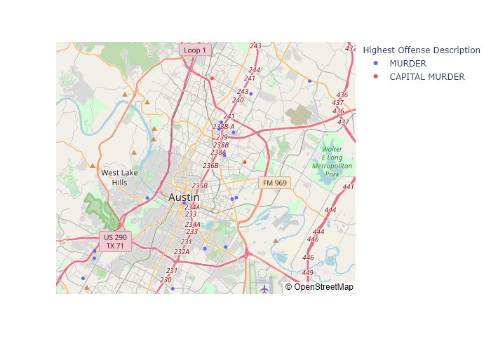
Murder 2019
Murder 2020

Slide 15
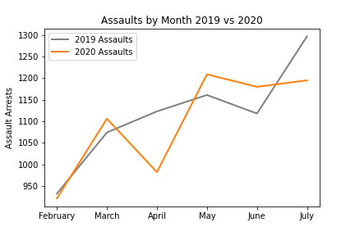
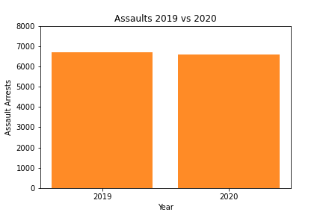
assault
BY MONTH
TOTAL

Slide 16
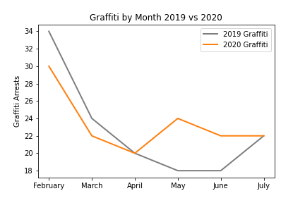
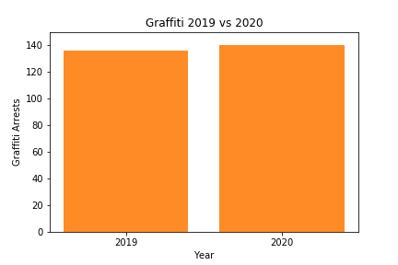
graFfiti
BY MONTH
TOTAL

Slide 17
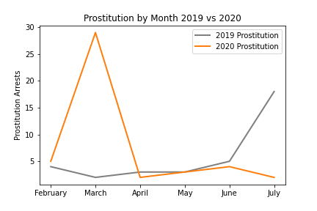
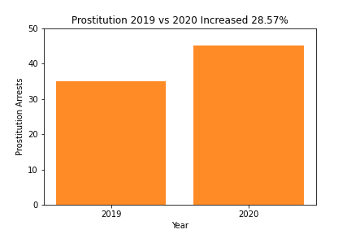
prostitution
BY MONTH
TOTAL

Slide 18
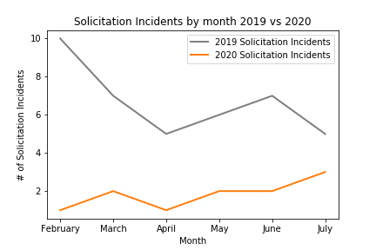
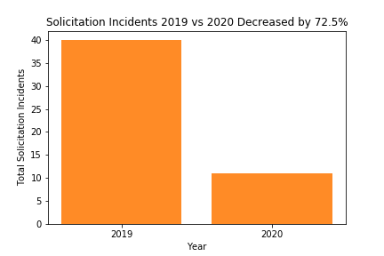
Solicitation
BY MONTH
TOTAL

Slide 19
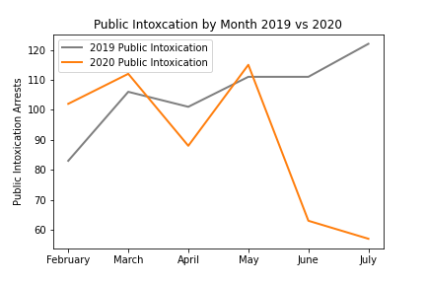
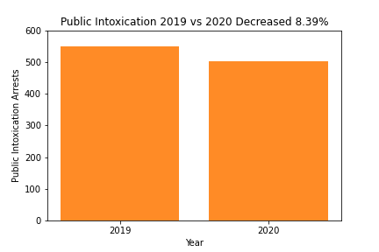
Public intoxication
BY MONTH
TOTAL

Slide 20
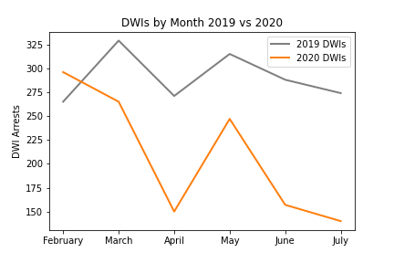
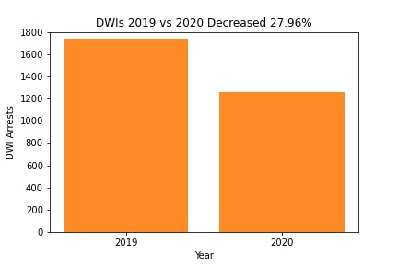
DWI
BY MONTH
TOTAL

Slide 21
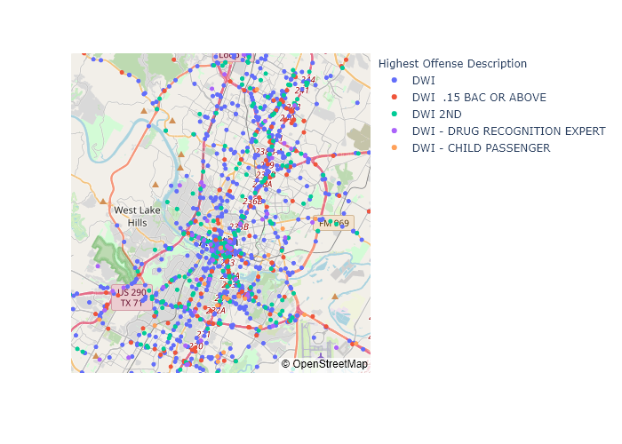
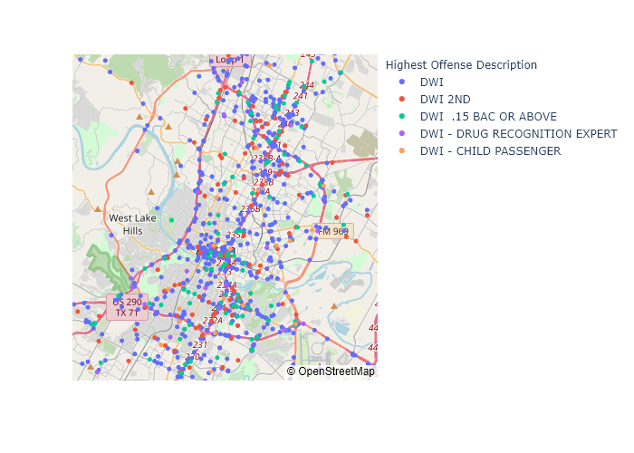
DWI 2019
Dwi 2020

Slide 22
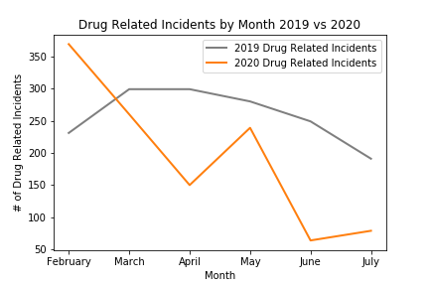
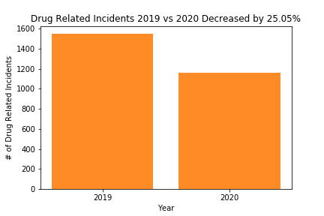
DRUG RELATED INCIDENTS
BY MONTH
TOTAL

Slide 23
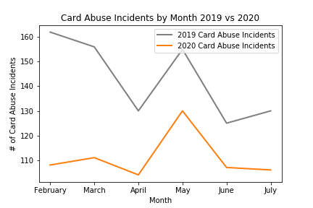
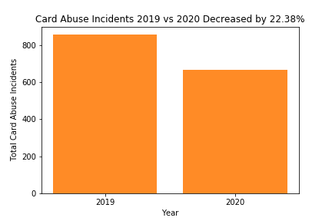
Card Abuse
BY MONTH
TOTAL

Slide 24
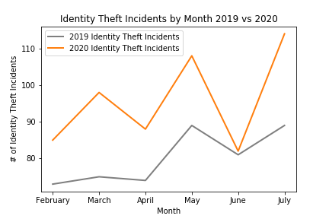
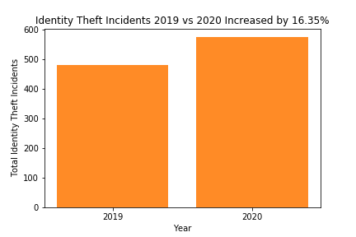
Identity theft
BY MONTH
TOTAL

Slide 25
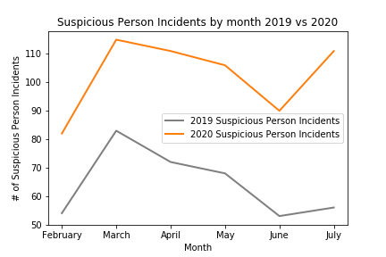
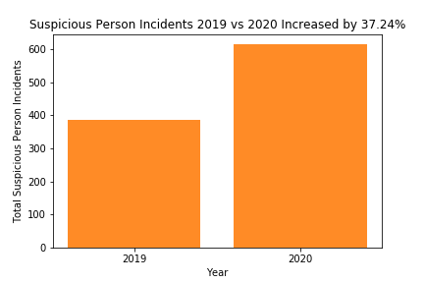
SUSPICIOUS PERSON
BY MONTH
TOTAL

Slide 26
CONCLUSIONS
What results matched expectations?
What results did not match expectations?
Murder increased 33.33%
Public Intoxication decreased 8.39%
DWIs decreased 27.96%
Public Intoxication and DWIs increased when bars were open and decreased when bars were closed
Total crime was approximately equal
Assault arrests were approximately equal
Graffiti arrests were approximately equal
Prostitution spiked in March 2020 then decreased dramatically. News stories confirmed that the Human Rights Commission recommended that Austin PD stop arrests and prosecution of prostitution similar to lesser drug possession.

Slide 27
Questions?
https://github.com/svillemez/Crime_in_the_Time_of_COVID

